Slide 1
AESTHETIC MEDICINE & CLINICAL WELLNESS
Applications of InBody in Aesthetics & Wellness
Research-Backed Body Composition Precision for Body Contouring, Muscle Sculpting, and Anti-Aging Diagnostics
Contouring Precision
Cellular Health & Phase Angle
Objective Progress Proof

Slide 2

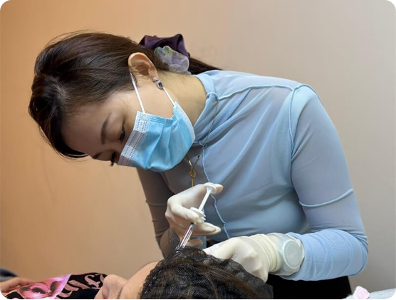
INDUSTRY PARADIGM SHIFT
Moving Beyond Scale Weight in Aesthetic Consultations
The Limitations of BMI & Weight
Scale weight fails to distinguish localized fat loss from muscle depletion.
Medical-Grade BIA Accuracy
98.4% correlation with DEXA scans without radiation or complex setup.
Direct Segmental Measurement
Evaluates trunk, arms, and legs independently without empirical estimations.

Slide 3




CLINICAL PRACTICE
Core Applications in Aesthetic & Wellness Practices
Body Contouring
EMS Sculpting
Anti-Aging & Longevity
Post-Op Fluid Recovery
Pre and post tracking for cryolipolysis and radiofrequency treatments.
Quantifies skeletal muscle mass gains from electromagnetic stimulation.
Phase angle monitoring for cellular vitality and biological age assessment.
ECW/TBW ratio tracks post-procedural edema and lymphatic drainage.

Slide 4

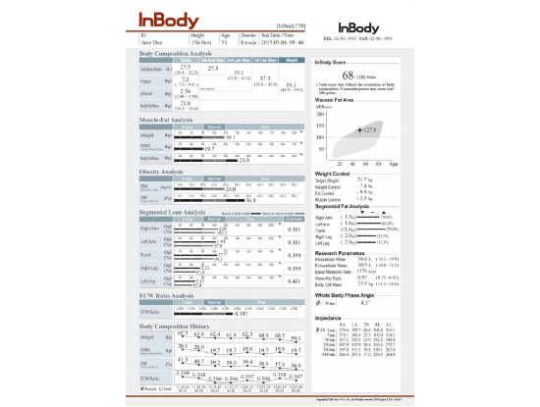
DIAGNOSTIC BLUEPRINT
Key Metrics on the InBody Result Sheet
1. Muscle-Fat Analysis
Compares weight, SMM, and body fat mass to identify 'C', 'I', or 'D' shaped profiles.
2. Visceral Fat Level (1–20 Scale)
Measures internal abdominal organ fat linked to metabolic risk. Target is below 10.
3. Segmental Lean & Fat Analysis
Pinpoints exact fat stores and muscle balance across right arm, left arm, trunk, and legs.
4. ECW/TBW Hydration Ratio
Evaluates extracellular fluid balance to detect systemic inflammation or swelling.

Slide 5
RESEARCH-BACKED RELIABILITY
Evidence-Based Science & Clinical Precision
98.4%
60 Sec
8-Point
DEXA Validation
Non-Invasive Scan
Tactile Electrodes
Gold-standard correlation in clinical trials for fat and muscle evaluation.
Rapid multi-frequency bioelectrical impedance testing without discomfort.
Patented thumb and foot electrode setup yields 99% measurement reproducibility.

Slide 6



PRACTICE GROWTH
Elevating Patient Adherence & Clinic ROI
Tangible Proof of Results
Customized Care Plans
Long-Term Retention
Visual fat reduction graphs justify multi-session body sculpting packages.
Combines medical weight management with aesthetic treatments accurately.
Serial progress scans keep patients motivated and coming back.

Slide 7
TARGETED DIAGNOSTICS
Direct Segmental Fat & Muscle Analysis
Trunk & Abdominal Focus
Limb Symmetry Evaluation
Edema vs. Fat Differentiation
Measures visceral fat and trunk fat mass before cryolipolysis or laser lipolysis.
Detects muscle imbalances between left and right arms or legs for EMS tuning.
Prevents confusing post-op fluid swelling with treatment inefficiency.

Slide 8
CLINICAL SUMMARY
Transforming Aesthetic Medicine Through Objective Body Data
Combining clinical-grade body composition analytics with modern aesthetic therapies for quantifiable client satisfaction and long-term wellness.
100%
0%
98.4%
Objective Proof
Empirical Guesswork
DEXA Accuracy

Slide 9


Image Sources
https://mediaesthetic.com.my/wp-content/uploads/2026/07/Medi-Clinic-Johor-Bahru-doctor-led-aesthetic-consultation.jpg
Source: mediaesthetic.com.my
https://inbodyasia.com/wp-content/uploads/2024/08/Result-Sheets-InBody770-scaled-1.png
Source: inbodyasia.com

